Slide 1

DATA PREPARATION (UNIT 1) MCA 3RD SEMESTER SIKKIM UNIVERSITY -PRATIKSHYA SHARMA

Slide 2
Contents
Introduction to Data Types
Quantitative vs Qualitative data types
Nominal , Ordinal, Nominal vs Ordinal
Discrete, Continuous, Discrete vs Continuous
Ratio
Introduction to Data Preparation
Normalization
Discretization
Missing Value Estimation
Sampling
Feature Selection

Slide 3
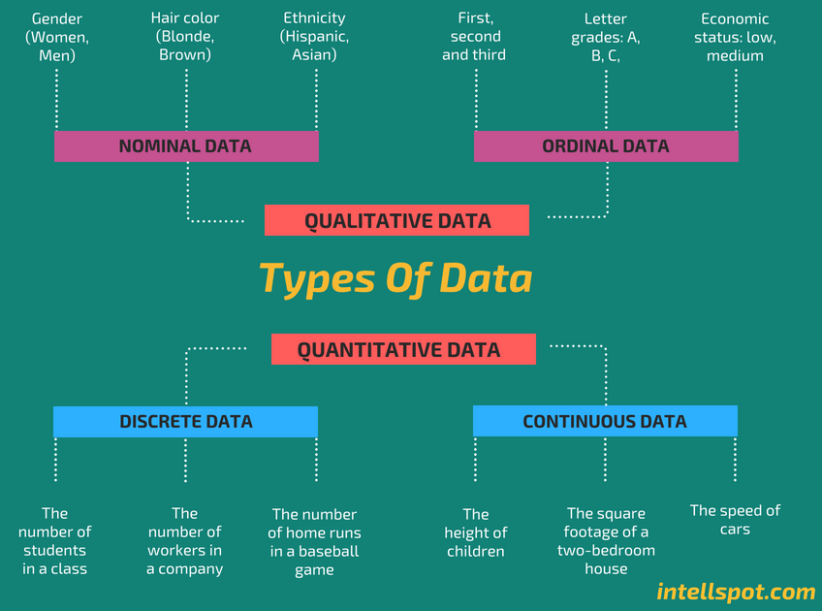

Slide 4
Quantitative Data
Quantitative data seems to be the easiest to explain. It answers key questions such as “how many, “how much” and “how often”.
Quantitative data can be expressed as a number or can be quantified. Simply put, it can be measured by numerical variables.
Quantitative data are easily amenable to statistical manipulation and can be represented by a wide variety of statistical types of graphs and charts such as line, bar graph, scatter plot, and etc.
Examples of quantitative data:
Scores on tests and exams e.g., 85, 67, 90 and etc.
The weight of a person or a subject.
Your shoe size.
The temperature in a room.
There are 2 general types of quantitative data: discrete data and continuous data.

Slide 5
Qualitative Data
Qualitative data can’t be expressed as a number and can’t be measured.
Qualitative data consist of words, pictures, and symbols, not numbers.
Qualitative data is also called categorical data because the information can be sorted by category, not by number.
Qualitative data can answer questions such as “how this has happened” or and “why this has happened”.
Examples of qualitative data:
Colors e.g. the color of the sea
Your favorite holiday destination such as Hawaii, New Zealand and etc.
Names as John, Patricia,…..
Ethnicity such as American Indian, Asian, etc.
More you can see on our post qualitative vs quantitative data.
There are 2 general types of qualitative data: nominal data and ordinal data.

Slide 6
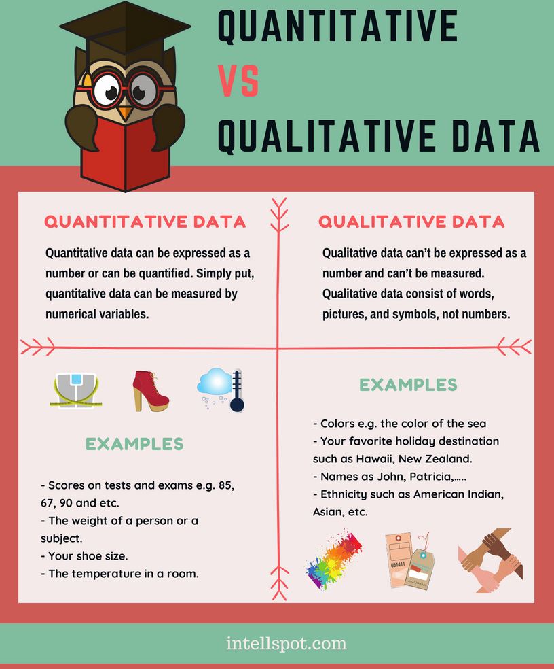

Slide 7
Nominal Data
Nominal data is used just for labeling variables, without any type of quantitative value. The name ‘nominal’ comes from the Latin word “nomen” which means ‘name’.
The nominal data just name a thing without applying it to order. Actually, the nominal data could just be called “labels.”
Examples of Nominal Data:
Gender (Women, Men)
Hair color (Blonde, Brown, Brunette, Red, etc.)
Marital status (Married, Single, Widowed)
Ethnicity (Hispanic, Asian)
As you see from the examples there is no intrinsic ordering to the variables.
Eye color is a nominal variable having a few categories (Blue, Green, Brown) and there is no way to order these categories from highest to lowest.

Slide 8
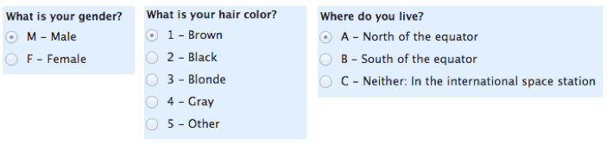
Nominal Data

Slide 9
Ordinal Data
Ordinal data shows where a number is in order. This is the crucial difference from nominal types of data.
Ordinal data is data which is placed into some kind of order by their position on a scale. Ordinal data may indicate superiority.
However, you cannot do arithmetic with ordinal numbers because they only show sequence.
Ordinal variables are considered as “in between” qualitative and quantitative variables.
In other words, the ordinal data is qualitative data for which the values are ordered.
In comparison with nominal data, the second one is qualitative data for which the values cannot be placed in an ordered.
We can also assign numbers to ordinal data to show their relative position. But we cannot do math with those numbers. For example: “first, second, third…etc.”
Examples of Ordinal Data:
The first, second and third person in a competition.
Letter grades: A, B, C, and etc.
When a company asks a customer to rate the sales experience on a scale of 1-10.
Economic status: low, medium and high.

Slide 10
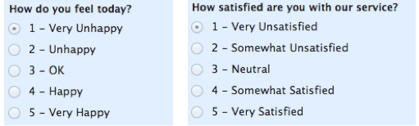
Ordinal Data

Slide 11
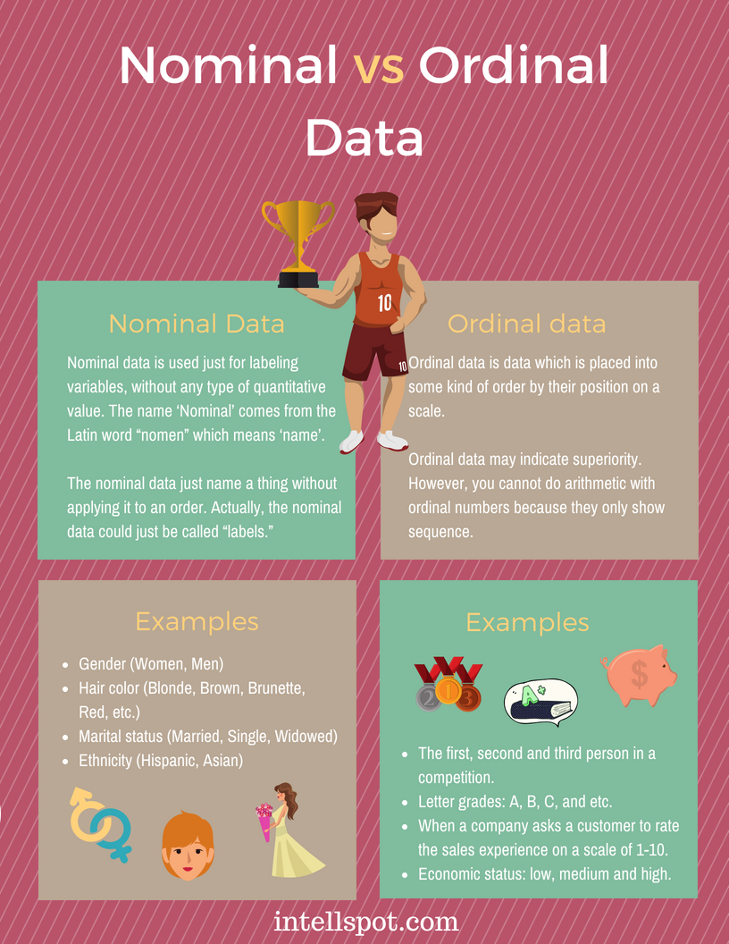

Slide 12
Nominal vs. Ordinal Data
Nominal Data | Ordinal Data
Nominal data can’t be quantified, neither they have any intrinsic ordering | Ordinal data gives some kind of sequential order by their position on the scale
Nominal data is qualitative data or categorical data | Ordinal data is said to be “in-between” qualitative data and quantitative data
They don’t provide any quantitative value, neither we can perform any arithmetical operation | They provide sequence and can assign numbers to ordinal data but cannot perform the arithmetical operation
Nominal data cannot be used to compare with one another | Ordinal data can help to compare one item with another by ranking or ordering
Examples: Eye colour, housing style, gender, hair colour, religion, marital status, ethnicity, etc | Examples: Economic status, customer satisfaction, education level, letter grades, etc

Slide 13
Discrete Data
Discrete and continuous data are the two key types of quantitative data.
In statistics, marketing research, and data science, many decisions depend on whether the basic data is discrete or continuous.
Discrete data is a count that involves only integers. The discrete values cannot be subdivided into parts.
For example, the number of children in a class is discrete data. You can count whole individuals. You can’t count 1.5 kids.
To put in other words, discrete data can take only certain values. The data variables cannot be divided into smaller parts.
It has a limited number of possible values e.g., days of the month.
Examples of discrete data:
The number of students in a class.
The number of workers in a company.
The number of home runs in a baseball game.
The number of test questions you answered correctly

Slide 14
Continuous Data
Continuous data is information that could be meaningfully divided into finer levels. It can be measured on a scale or continuum and can have almost any numeric value.
For example, you can measure your height at very precise scales — meters, centimeters, millimeters and etc.
You can record continuous data at so many different measurements – width, temperature, time, and etc. This is where the key difference from discrete types of data lies.
The continuous variables can take any value between two numbers. For example, between 50 and 72 inches, there are literally millions of possible heights: 52.04762 inches, 69.948376 inches and etc.
A good great rule for defining if a data is continuous or discrete is that if the point of measurement can be reduced in half and still make sense, the data is continuous.
Examples of continuous data:
The amount of time required to complete a project.
The height of children.
The square footage of a two-bedroom house.
The speed of cars.

Slide 15
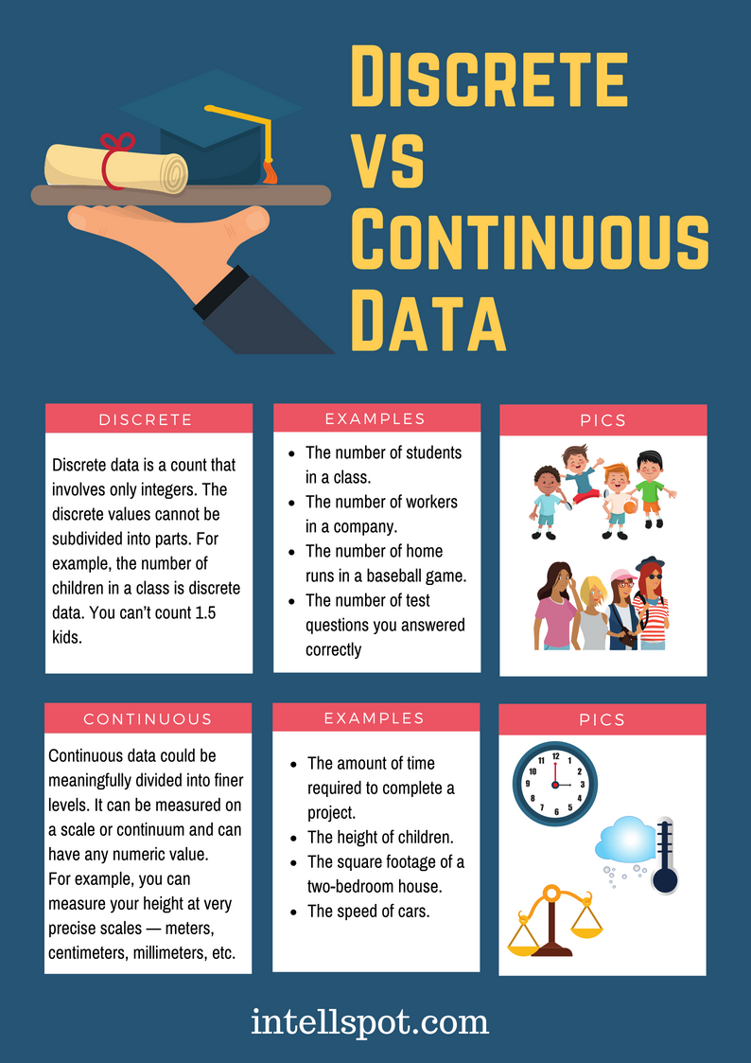

Slide 16
Discrete vs. Continuous Data
Discrete Data | Continuous Data
Discrete data are countable and finite; they are whole numbers or integers | Continuous data are measurable; they are in the form of fraction or decimal
Discrete data are represented mainly by bar graphs | Continuous data are represented in the form of a histogram
The values cannot be divided into subdivisions into smaller pieces | The values can be divided into subdivisions into smaller pieces
Discrete data have spaces between the values | Continuous data are in the form of a continuous sequence
Examples: Total students in a class, number of days in a week, size of a shoe, etc | Example: Temperature of room, the weight of a person, length of an object, etc

Slide 17
Ratio
Ratio scale data is quantitative in nature due to which all quantitative analysis techniques can be used to calculate ratio data.
Ratio Scale Examples
The following questions fall under the Ratio Scale category:
What is your daughter’s current height?
Less than 5 feet.
5 feet 1 inch – 5 feet 5 inches
5 feet 6 inches- 6 feet
More than 6 feet
What is your weight in kilograms?
Less than 50 kilograms
51- 70 kilograms
71- 90 kilograms
91-110 kilograms
More than 110 kilograms

Slide 18

DATA PREPARATION

Slide 19
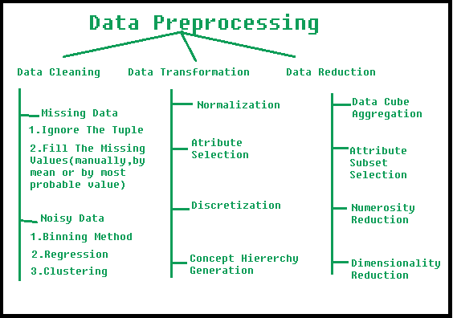

Slide 20
DATA PREPARATION
NORMALIZATION
DISCRETIZATION
MISSING VALUE ESTIMATION
SAMPLING
FEATURE SELECTION

Slide 21
DATA PREPARATION
NORMALIZATION

Slide 22
Normalization
Data normalization is mainly needed to minimize or exclude duplicate data.
Normalization in data mining is a beneficial procedure as it allows achieving certain advantages as mentioned below:
It is a lot easier to apply data mining algorithms on a set of normalized data.
The results of data mining algorithms applied to a set of normalized data are more accurate and effective.
Once the data is normalized, the extraction of data from databases becomes a lot faster.
More specific data analyzing methods can be applied to normalized data.
Popular Techniques for Data Normalization
Min Max Normalization
Decimal Scaling Normalization
Z-Score Normalization

Slide 23
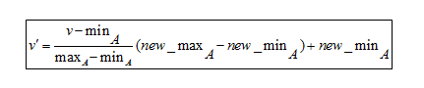
Min-Max Normalization
What is easier to understand – the difference between 200 and 1000000 or the difference between 0.2 and 1?
When the difference between the minimum and maximum values is less, the data becomes more readable.
The min-max normalization functions by converting a range of data into a scale that ranges from 0 to 1.

Slide 24
Example.
Suppose a company wants to decide on a promotion based on the years of work experience of its employees.
So, it needs to analyze a database that looks like this:
Employee Name | Years of Experience
ABC | 8
XYZ | 20
PQR | 10
MNO | 15

Slide 25
Employee Name | Years of Experience
ABC | 8
XYZ | 20
PQR | 10
MNO | 15
The minimum value is 8
The maximum value is 20
As this formula scales the data between 0 and 1,
The new min is 0
The new max is 1
Here, V stands for the respective value of the attribute, i.e., 8, 10, 15, 20
After applying the min-max normalization formula, the following are the V’ values for the attributes:
For 8 years of experience: v’= 0
For 10 years of experience: v’ = 0.16
For 15 years of experience: v’ = 0.58
For 20 years of experience: v’ = 1
So, the min-max normalization can reduce big numbers to much smaller values. This makes it extremely easy to read the difference between the ranging numbers.

Slide 26
Decimal Scaling Normalization
Decimal scaling is another technique for normalization in data mining.
It functions by converting a number to a decimal point.
Normalization by decimal scaling follows the method of standard deviation.
In decimal scaling normalization, the decimal point of values of the attributes is moved.
The movement of the decimal points in decimal scaling normalization is dependent upon the maximum values amongst all values of the attribute.

Slide 27
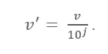
Formula:
Here:
V’ is the new value after applying the decimal scaling
V is the respective value of the attribute
Now, integer J defines the movement of decimal points. So, how to define it? It is equal to the number of digits present in the maximum value in the data table.

Slide 28
Suppose a company wants to compare the salaries of the new joiners. Here are the data values:
Employee Name | Salary
ABC | 10,000
XYZ | 25,000
PQR | 8,000
MNO | 15,000
Now, look for the maximum value in the data.
In this case, it is 25,000.
Now count the number of digits in this value.
In this case, it is ‘5’.
So here ‘j’ is equal to 5, i.e 100,000.
This means the V (value of the attribute) needs to be divided by 100,000 here.

Slide 29
Name | Salary | Salary after Decimal Scaling
ABC | 10,000 | 0.1
XYZ | 25, 000 | 0.25
PQR | 8, 000 | 0.08
MNO | 15,000 | 0.15
After applying the zero decimal scaling formula, here are the new values:
Thus, decimal scaling can tone down big numbers into easy to understand smaller decimal values.
Also, data attributed to different units becomes easy to read and understand once it is converted into smaller decimal values.

Slide 30
Z-Score Normalization
Z-Score value is to understand how far the data point is from the mean.
Technically, it measures the standard deviations below or above the mean.
It ranges from -3 standard deviation up to +3 standard deviation. Z-score normalization in data mining is useful for those kinds of data analysis wherein there is a need to compare a value with respect to a mean(average) value, such as results from tests or surveys.
Thus, Z-score normalization is also popularly known as Standardization.
The following formula is used in the case of z-score normalization on every single value of the dataset.

Slide 31
Formula : New value = (x – μ) / σ
Here:
x: Original value
μ: Mean of data
σ: Standard deviation of data

Slide 32
Data
3
5
5
8
9
12
12
13
15
16
17
19
22
24
25
134
Suppose we have the following dataset:
Therefore, we can find that the mean of this dataset is 21.2 also the standard deviation is 29.8.
If we have to perform z score normalization on the first value of the dataset,
Then according to the formula it will be,
New value = (x – μ) / σ
New value = (3-21.2)/ 29.8
∴ New value = -0.61
By performing z score normalization on each of the value of the dataset, we will get the following chart.

Slide 33
Data | Z score normalized value
3 | -0.61
5 | -0.54
5 | -0.54
8 | -0.44
9 | -0.41
12 | -0.31
12 | -0.31
13 | -0.28
15 | -0.21
16 | -0.17
17 | -0.14
19 | -0.07
22 | 0.03
24 | 0.09
25 | 0.13
134 | 3.79
The mean of this normalized dataset is 0 and the standard deviation is 1.
For example, a person’s weight is 150 pounds.
Now, if there is a need to compare that value with the average weight of a population listed in a vast table of data, Z-score normalization is needed to study such values, especially if someone’s weight is recorded in kilograms.

Slide 34
Difference between Min Max normalization and Z Score Normalization:
Min Max normalization | Z Score Normalization
For scaling the minimum and maximum values of the feature are used. Applicable when the features are of different sizes The values are scaled between the range of [0,1] or [-1, 1] Gets easily affected by outliers A transformer named MaxMinScaler is available in Scikit-Learn This method transforms an n-dimensional data into an n-dimensional unit hypercube Best if the distribution is unknown Also known as Scaling Normalization | For scaling mean deviation and the standard deviation is used. Useful when want to maintain a zero mean and unit standard deviation. No fixed range is present Not that much affected by outliers. Transformer named StandardScaler is available in Scikit-Learn to perform the task. This method translates data to the mean vector of the original data and then either squeezes or expands it. Best when Normal or Gaussian distribution Also known as Standardization

Slide 35
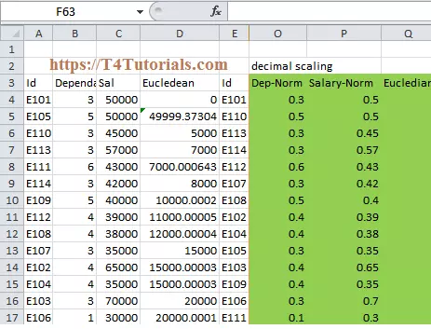
PROBLEMS:
Normalize the following group of data using min-max normalization–fol1000,2000,3000,9000
Normalise using decimal scale

Slide 36
Perform Z-score normalization
Answer
Question
marks | marks after z-score normalization
8 | -1.14
10 | -0.7
15 | 0.3
20 | 1.4
marks
8
10
15
20

Slide 37
DATA PREPARATION
DISCRETIZATION

Slide 38
Discretization
This is done to replace the raw values of numeric attribute by interval levels or conceptual levels.
It is a process of transforming continuous data into set of small intervals or into discrete buckets by grouping it.
It can significantly improve its efficiency by replacing a constant quality attribute with its discrete values.

Slide 39
Data Discretization Example
Suppose we have an attribute of age with the following values.
Table: Before discretization
Table: Before discretization
Age | 10,11,13,14,17,19,30, 31, 32, 38, 40, 42,70 , 72, 73, 75
Attribute | Age | Age | Age
 | 10,11,13,14,17,19 | 30, 31, 32, 38, 40, 42 | 70 , 72, 73, 75
After Discretization | Young | Mature | Old

Slide 40
What are some famous techniques of data discretization?
Histogram
Binning
Clustering analysis
Decision tree analysis

Slide 41
Histogram
It is a graphical representation of the distribution of a dataset.
A histogram is a plot that lets you show the underlying frequency distribution or the probability distribution of a single continuous numerical variable.
Histograms are two-dimensional plots with two axes; the vertical axis is a frequency axis whilst the horizontal axis is divided into a range of numeric values (intervals or bins) or time intervals.
The frequency of each bin is shown by the area of vertical rectangular bars.
Each bar covers a range of continuous numeric values of the variable under study.
The vertical axis shows frequency values derived from counts for each bin.
The midpoint value is the one that gives the name to the interval.
When a numerical value corresponds exactly to one of the boundaries of the interval, it will be assigned to the left or right interval according to the default setting of the visualization tool.

Slide 42
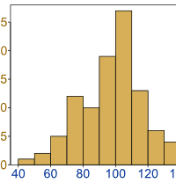
Creating a Histogram
Steps you must go through to create a Histogram.
Step 1 – Minimum Data Points
To accurately analyze a data set, it’s commonly recommended that you have at least 50 data points. Without an adequate amount of data, you cannot make reasonable conclusions about your data.
Basically, you may miss the pattern in the variation.
On the flip side of this requirement, one of the strengths of the Histogram is that it allows you to easily analyze large data sets.

Slide 43
Creating a Histogram
Step 2 – Number of Bins
Now that you’ve collected an adequate amount of data, it’s time to calculate the number of Bars, sometimes called Bins or Ranges, for your data set. The number of Bars for your Histogram will depend on the number of data points you collected.
Selecting the correct number of Bins is important as it can drastically affect the appearance of your data, which might lead you to the wrong conclusion.

Slide 44
Creating a Histogram
Step 3 – Determine Bin Width
Once you’ve determined the number of Bins for your Histogram, it’s time to calculate the Width or Range of each individual Bin.
To do that you take the entire Range of the data (Max data point minus Min data point) and divide by the total number of Bins.

Slide 45
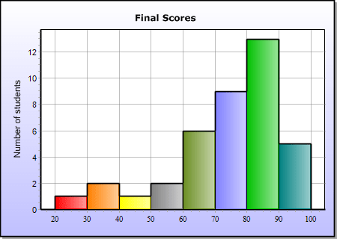
Creating a Histogram
So for example, let’s say you’re creating a Histogram of Student’s Test Scores on an exam and the maximum score was 100 and the minimum score was 20; then your Range is 80 i.e., (100 – 20).
Then you can divide your data Range (80), by the total number of Bins, lets say 8 in this instance. So the Width of each Bin is 80/ 8 = 10.
Similar to selecting the right number of total Bins, it’s important that you keep all the Bin widths the same or this will skew the distribution of the data.

Slide 46
Create a Histogram for following data
490
499
459
575
575
513
382
525
510
542
368
564
509
530
485
521
495
526
474
500
441
750
495
476
456
440
547
479
501
476
457
444
444
467
482
449
464
501
670
740
590
700
590
450
452
468
472
447
520
506
570
474
532
472
585
466
549
736
654
585
574
621
542
616
547
554
514
592
531
550
507
441
551
450
548
589
549
485
480
545
451
448
487
480
540
470
529
445
460
457
560
495
480
430
644
489
506
660
444
551
583
457
440
470
486
413
470
408
440
596
442
544
528
559
505
450
477
557
446
553
370
533
496
513
403
496
543
533
471
404
439
459
393
470
650
512
445
446
474
449
529
538
450
570
499
375
515
445
571
442
492
456
428
536
515
450
537
490
446
410
526
560
560
540
502
642
590
480
557
468
524
445
479

Slide 47
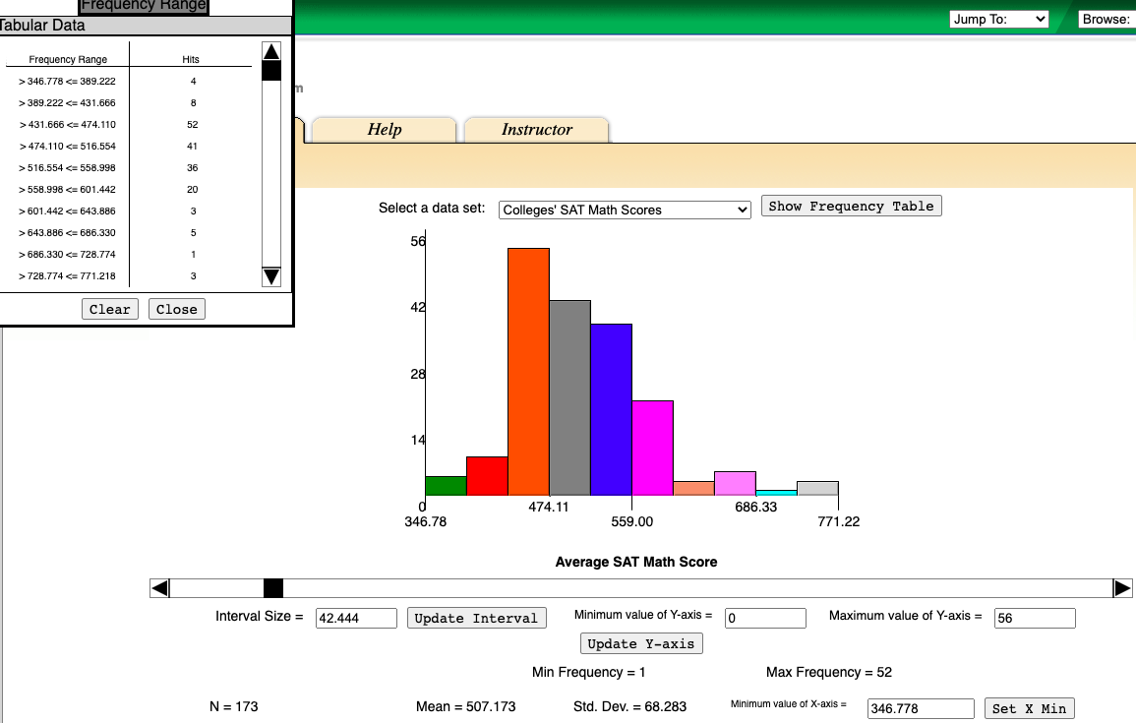

Slide 48
Binning
It is a pre-processing technique used to reduce the effects of minor observation errors.
The original data values are divided into small intervals known as bins, and then they are replaced by a general value calculated for that bin.
This has a soothing effect on the input data and may also reduce the chances of over fitting in the case of small datasets.
Binning of continuous variables introduces non-linearity and tends to improve the performance of the model.
It can also be used to identify missing values or outliers.

Slide 49
How do you Bin Data?
There are two methods of dividing data into bins and binning data:
2. Equal Width Binning: Bins have equal width with a range of each bin are defined as:
[min + w], [min + 2w] …. [min + nw] where w = (max - min) / (no of bins).
For example, equal Width:
Input: [5, 10, 11, 13, 15, 35, 50, 55, 72, 92, 204, 215]
Output:
[5, 10, 11, 13, 15, 35, 50, 55, 72]
[92]
[204, 215]
1. Equal Frequency Binning: Bins have an equal frequency.
For example, equal frequency:
Input: [5, 10, 11, 13, 15, 35, 50, 55, 72, 92, 204, 215]
Output:
[5, 10, 11, 13]
[15, 35, 50, 55]
[72, 92, 204, 215]

Slide 50
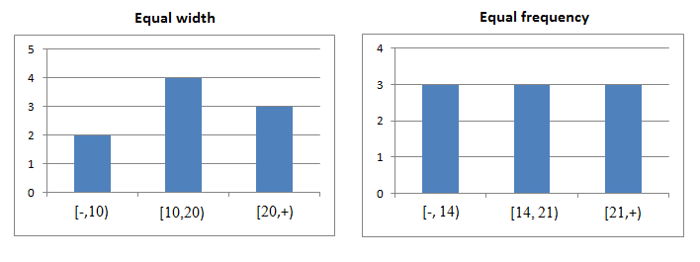
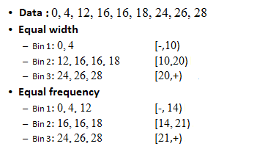
The algorithm divides the data into k groups which each group contains approximately same number of values. For the both methods, the best way of determining k is by looking at the histogram and try different intervals or groups.

Slide 51
Cluster Analysis
Cluster Analysis is the process to find similar groups of objects in order to form clusters. It is an unsupervised machine learning-based algorithm that acts on unlabelled data. A group of data points would comprise together to form a cluster in which all the objects would belong to the same group.
Cluster:
The given data is divided into different groups by combining similar objects into a group. This group is nothing but a cluster. A cluster is nothing but a collection of similar data which is grouped together.
For example, consider a dataset of vehicles given in which it contains information about different vehicles like cars, buses, bicycles, etc. As it is unsupervised learning there are no class labels like Cars, Bikes, etc for all the vehicles, all the data is combined and is not in a structured manner.
Now our task is to convert the unlabelled data to labelled data and it can be done using clusters.

Slide 52
K-Mean (A centroid based Technique)
The K means algorithm takes the input parameter K from the user and partitions the dataset containing N objects into K clusters so that resulting similarity among the data objects inside the group (intracluster) is high but the similarity of data objects with the data objects from outside the cluster is low (intercluster).
The similarity of the cluster is determined with respect to the mean value of the cluster.
At the start randomly k objects from the dataset are chosen in which each of the objects represents a cluster mean(centre).
For the rest of the data objects, they are assigned to the nearest cluster based on their distance from the cluster mean.
The new mean of each of the cluster is then calculated with the added data objects.

Slide 53
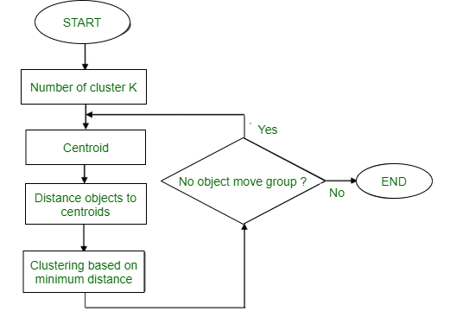
Algorithm: K mean:
Input: K: The number of clusters in which the dataset has to be divided D: A dataset containing N number of objects
Output: A dataset of K clusters
Method:
Randomly assign K objects from the dataset(D) as cluster centres(C)
(Re) Assign each object to which object is most similar based upon mean values.
Update Cluster means, i.e., Recalculate the mean of each cluster with the updated values.
Repeat Step 4 until no change occurs.
Flowchart:

Slide 54
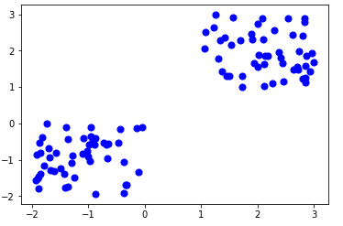
Figure – K-mean Clustering

Slide 55
Example:
Suppose we want to group the visitors to a website using just their age as follows:
Data: 16, 16, 17, 20, 20, 21, 21, 22, 23, 29, 36, 41, 42, 43, 44, 45, 61, 62, 66
Initial Cluster:
K=2 Centroid(C1) = 16 [16] Centroid(C2) = 22 [22]
Note: These two points are chosen randomly from the dataset.
Iteration-1:
C1 = 16.33 [16, 16, 17] C2 = 37.25 [20, 20, 21, 21, 22, 23, 29, 36, 41, 42, 43, 44, 45, 61, 62, 66]
Iteration-2:
C1 = 19.55 [16, 16, 17, 20, 20, 21, 21, 22, 23]
C2 = 46.90 [29, 36, 41, 42, 43, 44, 45, 61, 62, 66]
Iteration-3:
C1 = 20.50 [16, 16, 17, 20, 20, 21, 21, 22, 23, 29] C2 = 48.89 [36, 41, 42, 43, 44, 45, 61, 62, 66]
Iteration-4:
C1 = 20.50 [16, 16, 17, 20, 20, 21, 21, 22, 23, 29] C2 = 48.89 [36, 41, 42, 43, 44, 45, 61, 62, 66]
No change
Between Iteration 3 and 4, so we stop.
Therefore, we get the clusters (16-29) and (36-66) as 2 clusters we get using K Mean Algorithm.

Slide 56
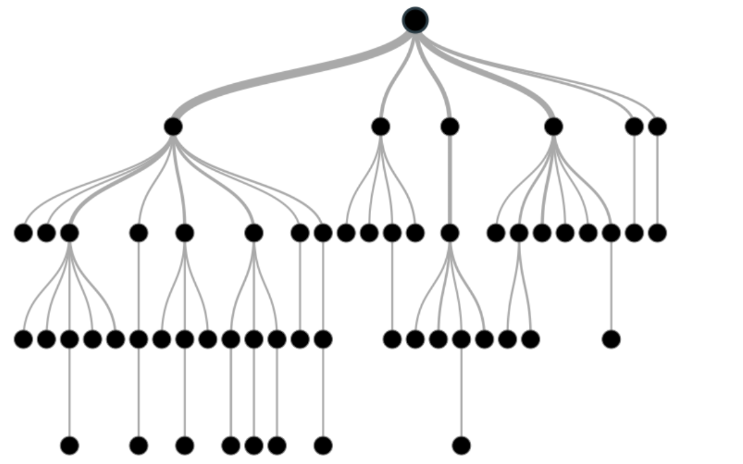
Decision Tree Analysis
In decision analysis, a decision tree can be used to visually and explicitly represent decisions and decision making. As the name goes, it uses a tree-like model of decisions.
Decision trees can be used for classification as well as regression problems. The name itself suggests that it uses a flowchart like a tree structure to show the predictions that result from a series of feature-based splits. It starts with a root node and ends with a decision made by leaves.

Slide 57
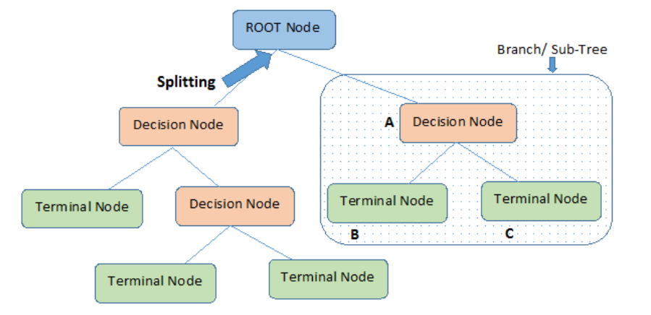
Before learning more about decision trees let’s get familiar with some of the terminologies.
Root Nodes – It is the node present at the beginning of a decision tree from this node the population starts dividing according to various features.
Decision Nodes – the nodes we get after splitting the root nodes are called Decision Node
Leaf Nodes – the nodes where further splitting is not possible are called leaf nodes or terminal nodes
Sub-tree – just like a small portion of a graph is called sub-graph similarly a sub-section of this decision tree is called sub-tree.
Pruning – is nothing but cutting down some nodes to stop overfitting.

Slide 58
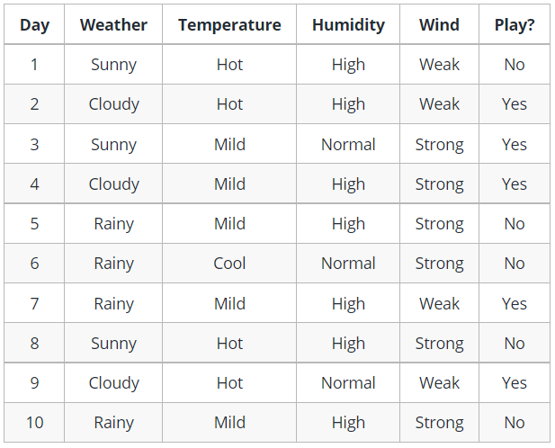
Example - decision tree

Slide 59
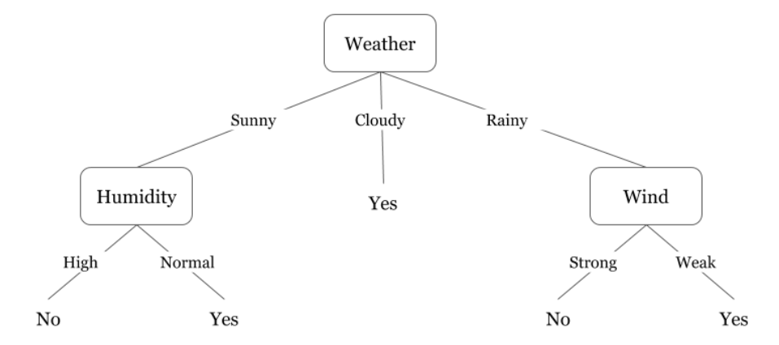
Decision trees are upside down which means the root is at the top and then this root is split into various several nodes.
Decision trees are nothing but a bunch of if-else statements in layman terms.
It checks if the condition is true and if it is then it goes to the next node attached to that decision.

Slide 60
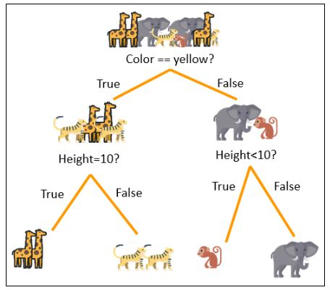
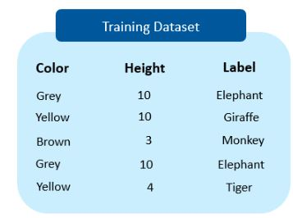
Example
The following is an example of a simple decision tree used to classify different animals based on their features. We will be using the color and height of the animals as input features.

Slide 61
DATA PREPARATION
MISSING VALUE ESTIMATION

Slide 62
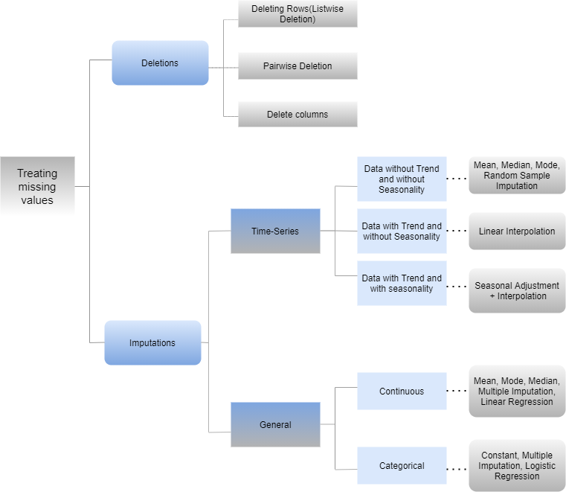

Slide 63
MISSING VALUE ESTIMATION
Imputation is that the method of substituting missing data with substituted values. Two types of Imputations are majorly categorized
General
Time-Series
General Data
General data is mainly imputed by mean, mode, median, Linear Regression, Logistic Regression, Multiple Imputations, and constants.
Further General data is divided into two types Continuous and Categorical.
Here we are attending to take one dataset and that we shall apply some imputation techniques.

Slide 64
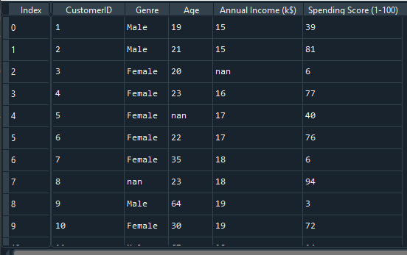
Example

Slide 65
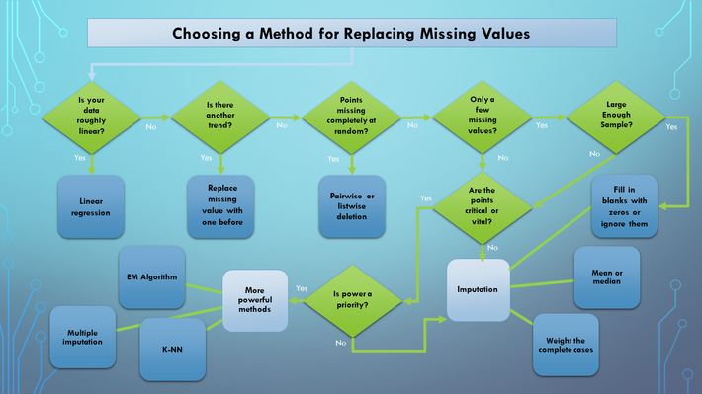

Slide 66
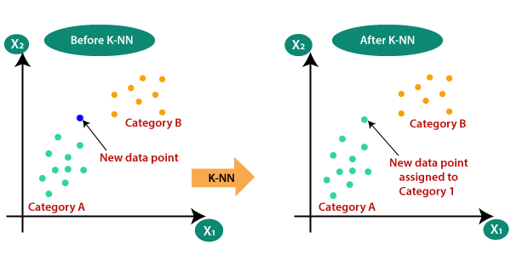
KNN

Slide 67
How does K-NN work?
The K-NN working can be explained on the basis of the below algorithm:
Step-1: Select the number K of the neighbors
Step-2: Calculate the Euclidean distance of K number of neighbors
Step-3: Take the K nearest neighbors as per the calculated Euclidean distance.
Step-4: Among these k neighbors, count the number of the data points in each category.
Step-5: Assign the new data points to that category for which the number of the neighbor is maximum.
Step-6: Our model is ready.

Slide 68
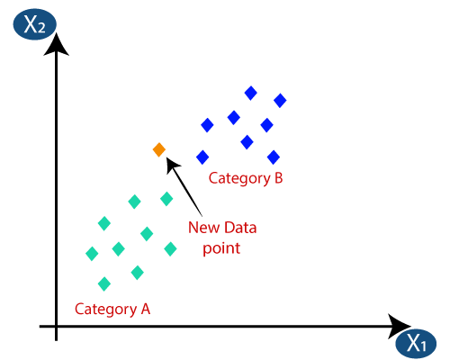
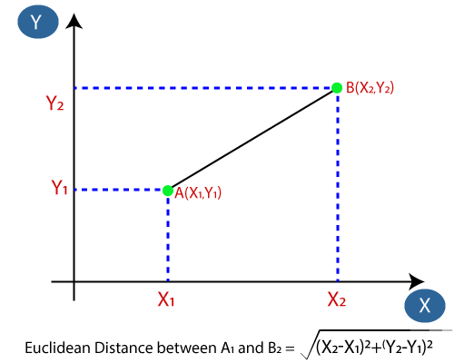
Suppose we have a new data point and we need to put it in the required category. Consider the below image:
Firstly, we will choose the number of neighbors, so we will choose the k=5.
Next, we will calculate the Euclidean distance between the data points. The Euclidean distance is the distance between two points, which we have already studied in geometry. It can be calculated as:

Slide 69
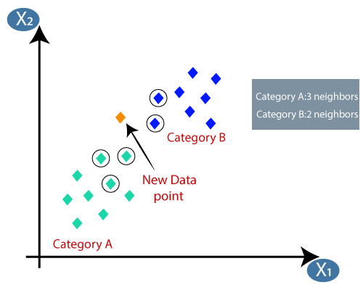
By calculating the Euclidean distance we got the nearest neighbors, as three nearest neighbors in category A and two nearest neighbors in category B. Consider the image:
As we can see the 3 nearest neighbors are from category A, hence this new data point must belong to category A.

Slide 70
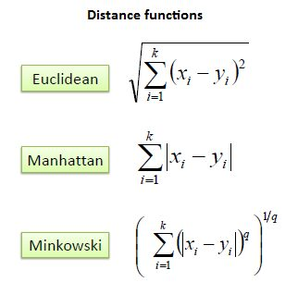

Slide 71
How to select the value of K in the K-NN Algorithm?
Below are some points to remember while selecting the value of K in the K-NN algorithm:
There is no particular way to determine the best value for "K", so we need to try some values to find the best out of them. The most preferred value for K is 5.
A very low value for K such as K=1 or K=2, can be noisy and lead to the effects of outliers in the model.
Large values for K are good, but it may find some difficulties.

Slide 72
Advantages of KNN Algorithm:
It is simple to implement.
It is robust to the noisy training data
It can be more effective if the training data is large.
Disadvantages of KNN Algorithm:
Always needs to determine the value of K which may be complex some time.
The computation cost is high because of calculating the distance between the data points for all the training samples.

Slide 73
Example (KNN)
Solution:
Assume neighbors, k = 3
Calculate distance between new data(3,7) and three neighbors.
Durability | Strength | Calculate Distance to (3,7)
7 | 7 | (7-3)²+(7-7)² = 16
7 | 4 | (7-3)²+(4-7)² = 25
3 | 4 | (3-3)²+(4-7)² = 9
1 | 4 | (1-3)²+(4-7)² = 13
Durability | Strength | Class
7 | 7 | Bad
7 | 4 | Bad
3 | 4 | Good
1 | 4 | Good
A factory produces special paper tissue, based on the parameters the aim is to determine if the paper tissue produced is of good quality or not.
New Data:
Durability :7, Strength : 3
Determine its class.
Durability | Strength | Calculate Distance to (3,7) | Rank | Within nearest neighbor of 3?
7 | 7 | (7-3)²+(7-7)² = 16 | 3 | Yes
7 | 4 | (7-3)²+(4-7)² = 25 | 4 | No
3 | 4 | (3-3)²+(4-7)² = 9 | 1 | Yes
1 | 4 | (1-3)²+(4-7)² = 13 | 2 | Yes

Slide 74
Example (KNN)
Durability | Strength | Class
7 | 7 | Bad
7 | 4 | Bad
3 | 4 | Good
1 | 4 | Good
Durability | Strength | Calculate Distance to (3,7) | Rank | Within nearest neighbor of 3? | Predicted Class
7 | 7 | (7-3)²+(7-7)² = 16 | 3 | Yes | Bad
7 | 4 | (7-3)²+(4-7)² = 25 | 4 | No | -
3 | 4 | (3-3)²+(4-7)² = 9 | 1 | Yes | Good
1 | 4 | (1-3)²+(4-7)² = 13 | 2 | Yes | Good
Final : (3,7) is classified as Good

Slide 75
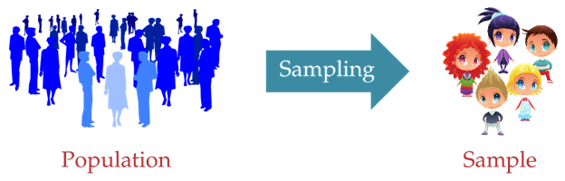
Sampling
In the world of Statistics, the very first thing to be done before any estimation is to create a Sample set from the entire Population Set.
The Population set can be seen as the entire tree from where data is collected whereas the Sample Set can be seen as the branch in which the actual study of observations and estimation is done.
Population tree is a very large set and making the study of observations on it can be very exhausting, both time and money-wise alike.
Thus, to cut down on the amount of time and as well as resources, a Sample Set is created from the Population set.

Slide 76
Important Terms
Population
The total number of people or things you are interested in. Population is the whole set of variables, elements, entities which are considered for a statistical study. It is also known as the universal set from where actual inferences are drawn. Population set consists of all the attributes of individuals or elements under consideration, but doing estimations on a Population is very exhausting resources as well as time-wise alike.
Sample A smaller number within your population that will represent the whole
Sampling The process and method of selecting your sample

Slide 77
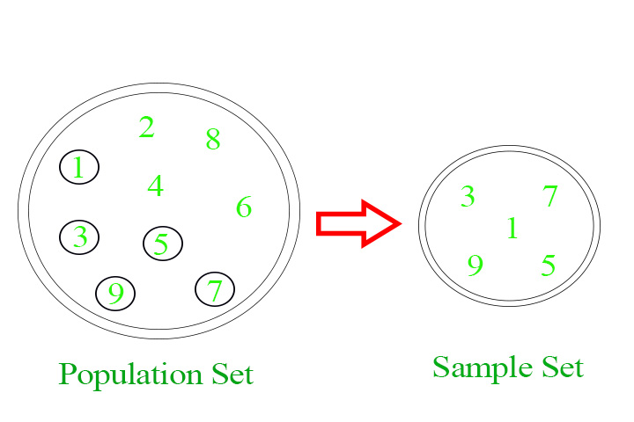
Process of Sampling
Identifying the Population set.
Determination of the size of our sample set.
Providing a medium for the basis of selection of samples from the Population medium.
Picking out samples from the medium using one of many Sampling techniques like Simple Random, Systematic or Stratified Sampling.
Checking whether the formed sample set, contains elements actually matches the different attributes of population set, without large variations in between.
Checking for errors or inaccurate estimations in the formed sample set, that may or may not have occurred
The set which we get after performing the above steps actually contributes to the Sample Set.

Slide 78
Methods and Types of sampling:
Simple Random Sampling
Systematic Sampling
Stratified Sampling
These are the most widely used Sampling Processes with each having their both advantages as well as disadvantages. Let us look at each of these sampling methods in details:
Simple Random Sampling: Simple Random Sampling is the most elementary form of sampling. In this method, all the elements in populations are first divided into random sets of equal sizes. Random sets have no defining property among themselves, i.e. one set cannot be identified from another set based on some specific identifiers. Thus, every element has an equal property of being selected.
P(of getting selected) =

Slide 79
The basic methods for employing SRS are:
Choose the Population Set
Identify the basis of Sampling
Use of random number/session generators to pick an element from each set.
Less exhaustive with respect to time as it is the most elementary form of sampling
Very useful for population set with very less number of elements
SRS can be employed anywhere, anytime even without the use of special random generators
Not efficient for large population sets
Causes the most number of errors out of the three mentioned methods of sampling
There are chances of bias and then SRS won’t be able to provide a correct result
Does not provide a specific identifier to separate statistically similar samples

Slide 80
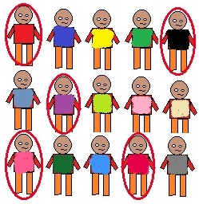
Example (Simple Random Sampling)
Random selection of 20 students from class of 50 student. Each student has equal chance of getting selected. Here probability of selection is 1/50.

Slide 81
2. Systematic Sampling:
Systematic Sampling is also known as a type of probability sampling. It is much more accurate than SRS and also the standard error formation percentage is very low but not error-free. In this method, first, the population tray elements are arranged based on a specific order or scheme properly known as being sorted. It can be of any order, which totally depends upon the person performing the statistics. The elements are first arranged either ascendingly, descending, lexicographically or any other known methods deemed fit by the tester. Although the start point needs to be random every time. After being arranged, then the sample elements are picked based on a pre-defined interval set or function.
Example: In a random set of numbers with elements ranging from 1 to 100. The elements are first sorted either in ascending or descending order. Then let’s say every 4th element is picked to be a part of the sampling frame. This kind of sampling is known as Systematic Sampling.
P(of getting selected) = [depends upon the ordered population tray after it has been sorted]

Slide 82
The basic methods of employing Systematic Random Sampling are :-Choosing the Population Set wisely
Checking whether Systematic Sampling will be the efficient method or not.
If Yes, then Application of an sorting method to get an ordered pair of population elements.
Choosing a periodicity to crawl out elements.
Accuracy is higher than SRS.
Standard probability of error is lesser .
No problem for bias to creep in during creation of sample frame.
Not much efficient when comes to the time wise
Periodicity in population tray elements can lead to absurd results.
Systematic sampling can either provide the most accurate result or an impossible one.

Slide 83
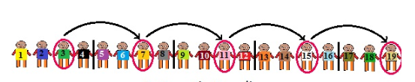
Example
For a sample of size n, we divide our population of size N into subgroups of k elements.
We select our first element randomly from the first subgroup of k elements.
To select other elements of sample, perform following:
We know number of elements in each group is k i.e N/n
So if our first element is n1 then
Second element is n1+k i.e n2
Third element n2+k i.e n3 and so on..
Taking an example of N=20, n=5
No of elements in each of the subgroups is N/n i.e 20/5 =4= k
Now, randomly select first element from the first subgroup.
If we select n1= 3
n2 = n1+k = 3+4 = 7
n3 = n2+k = 7+4 = 11

Slide 84
3. Stratified Sampling:
Stratified Sampling is the most complex type of Sampling Method out of all the three methods mentioned above.
It is a hybrid method concerning both simple random sampling as well as systematic sampling.
It is one of the most advanced types of sampling method available, providing near accurate result to the tester.
In this method, the population tray is divided into sub-segments also known as stratum(singular).
Each stratum can have their own unique property.
After being divided into different sub-stratum, SRS or Systematic Sampling can be used to create and pick out samples for performing statistics.

Slide 85
The elementary methods for Stratified Sampling are :
Choosing the population tray wisely.
Checking for periodicity or any other features, so that they can be divided into different strata
Dividing the population tray into sub-sets and sub-groups on the basis of selective property.
Using SRS or Systematic Sampling of each individual strata to form the sample frame.
We can even apply different sampling methods to different sub-sets.
Provide results with high accuracy measurements.
Different results can be desired just by changing the Sampling method.
This method also compares different strata when samples are being drawn.
Inefficient and Expensive when comes to resources as well as money.
This method will fail only in rare cases where homogeneity in elements is present.
These three are the widely used methods of Sampling which are being done nowadays. Each of them has their own advantages as well as disadvantages. So, the sampling method must be chosen wisely, because a wrong choice can lead to erroneous answers.

Slide 86
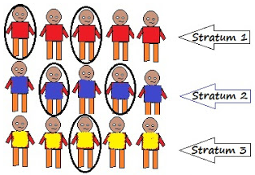
Example (Stratified Sampling)
This technique divides the elements of the population into small subgroups (strata) based on the similarity in such a way that the elements within the group are homogeneous and heterogeneous among the other subgroups formed. And then the elements are randomly selected from each of these strata. We need to have prior information about the population to create subgroups.

Slide 87
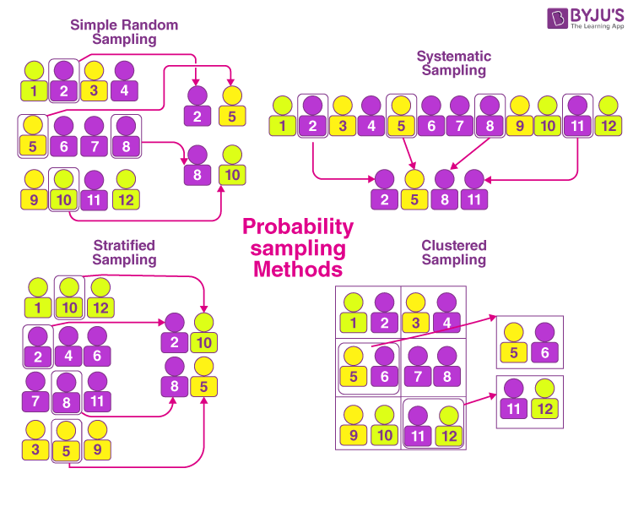

Slide 88
Feature Selection
We can summarize feature selection as follows.
Feature Selection: Select a subset of input features from the dataset.
Unsupervised: Do not use the target variable for selecting the feature importance of Input variable (e.g. remove redundant variables).
Correlation
Supervised: Use the target variable (e.g. remove irrelevant I/P features).
Wrapper Method: Search for well-performing subsets of features.
Recursive Feature Elimination (RFE)
Filter Method: Select subsets of features based on their relationship with the target.
Statistical Methods
Feature Importance Methods
Intrinsic: Algorithms that perform automatic feature selection during training.
Decision Trees
Dimensionality Reduction: Project input data into a lower-dimensional feature space.

Slide 89
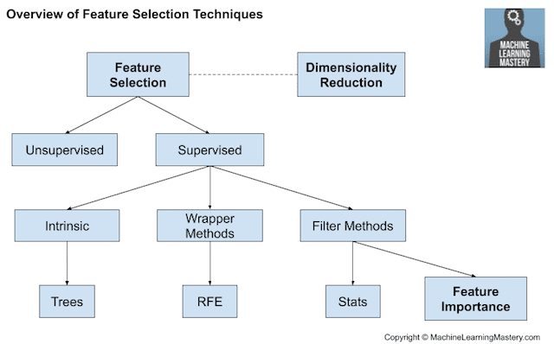
Feature Selection

Slide 90
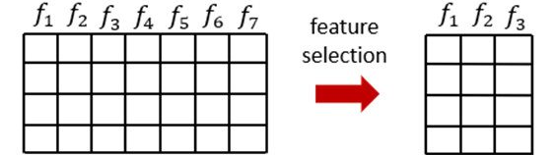
Feature Selection
In machine learning and statistics, feature selection, also known as variable selection, attribute selection or variable subset selection, is the process of reducing the number of input variables when developing a predictive model.
Feature selection techniques are used for several reasons:
It reduces model complexity by dropping some irrelevant features.
Helps ML algorithm to train a model faster.
Reduction of dimensionality helps in avoid overfitting.

Slide 91
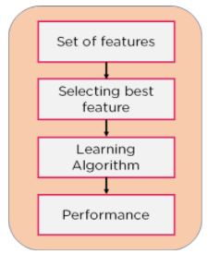
Methodologies used for feature selection.
1. Filter Method:
Filter feature selection methods use statistical techniques to evaluate the relationship between each input variable and the target variable, and these scores are used as the basis to choose (filter) those input variables that will be used in the model.
The statistical measures used in filter-based feature selection are generally calculated one input variable at a time with the target variable. As such, they are referred to as univariate statistical measures. This may mean that any interaction between input variables is not considered in the filtering process.
In this method, features are dropped based on their relation to the output, or how they are correlating to the output. We use correlation to check if the features are positively or negatively correlated to the output labels and drop features accordingly.
Eg: Information Gain, Chi-Square Test, Fisher’s Score, etc.
Note:- In this case, the existence of correlated predictors makes it possible to select important, but redundant, predictors. The obvious consequences of this issue are that too many predictors are chosen and, as a result, collinearity problems arise.

Slide 92
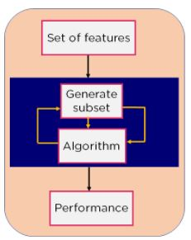
2. Wrapper Method:
Wrapper feature selection methods create many models with different subsets of input features and select those features that result in the best performing model according to a performance metric.
These methods are unconcerned with the variable types, although they can be computationally expensive.
Recursive Feature Elimination (RFE) is a good example of a wrapper feature selection method.
We split our data into subsets and train a model using this.
Based on the output of the model, we add and subtract features and train the model again.
It forms the subsets using a greedy approach and evaluates the accuracy of all the possible combinations of features.
Eg: Forward Selection, Backwards Elimination, etc.

Slide 93
Forward Selection: Forward selection is an iterative method in which we start with having no feature in the model. In each iteration, we keep adding the feature which best improves our model till an addition of a new variable does not improve the performance of the model.
Backward Elimination: In backward elimination, we start with all the features and removes the least significant feature at each iteration which improves the performance of the model. We repeat this until no improvement is observed on removal of features.
Recursive Feature elimination: It is a greedy optimization algorithm which aims to find the best performing feature subset. It repeatedly creates models and keeps aside the best or the worst performing feature at each iteration. It constructs the next model with the left features until all the features are exhausted. It then ranks the features based on the order of their elimination.

Slide 94
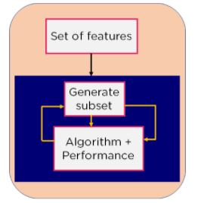
3. Embedded/Intrinsic Method:
Embedded methods combine the qualities of filter and wrapper methods.
This method takes care of the machine training iterative process while maintaining the computation cost to be minimum.
Eg: Lasso and Ridge Regression.

